Slide 1



Title –
Design of IOT Architecture for
Battery Charging Management Technology
Presentation on
Prototype – Plan of Action
Presented by
Jagadeesh – Jaswanth - Uttam
under the Esteemed guidance of
Dr. Sujith Kalluri Ph.D
Associate Professor
School of Engineering and Sciences (SEAS)
Department of Electronics and Communication Engineering
SRM University, Andhra Pradesh (SRM AP)

Slide 2

Outline
Problem Statement
Problem Statement and Research Gap with IOT Tech
Types of Charging Technology
Scope & Deliverables
Technical Specifications
System Design
Plan of Action (4 Milestones)
Budget Breakdown
System Design
PCC integration and Automation
Automation Energy Sensor monitoring
Integrating Energy source
Automation Energy source
Load source
Discharge unit
Bill of Material’s

Slide 3
Problem Statement
Challenges in Current EV Charging Infrastructure
Grid Instability:
  High-power EV charging causes voltage fluctuations, harmonics, and transformer overloads.
High Operational Costs:
  40% higher OPEX due to grid dependency and manual monitoring.
Renewable Integration Gaps:
  No standardized system to prioritize solar/ESS over grid power.
  Excess solar energy is wasted without storage (ESS).
Battery Management:
  Lack of real-time SOC/temperature monitoring reduces battery lifespan.
User Convenience:
  Slow charging times (4–6 hours for Level-II) and range anxiety deter EV adoption.

Slide 4

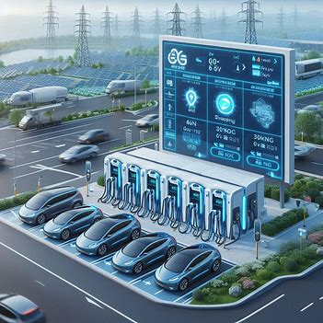
Problem Statement and Research Gap with IOT Tech
Lack of Pollution – need More Transportation – Need coal mines – More Generation cost
Why IOT needed
Real Time Data Monitoring
Pre estimation Power Demand
To Reuse Harmonic's Imbalance
Central Monitoring System
End User Integration
EV are Rapidly Increasing in the world Automotive Market
So, There is a Demand of Charging Infra

Slide 5

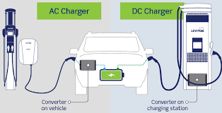
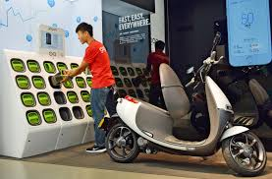
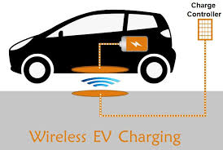
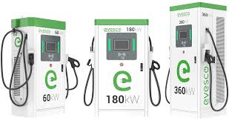
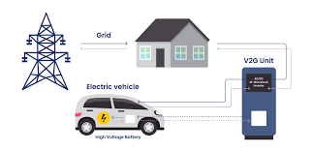
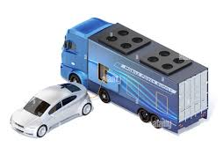
Types of Charging Technology
AC Charging
DC Charging
Battery Swapping
Wireless Charging
Vehicle-to-Grid (V2G) Technology
Fast Charging Technologies
Mobile charging

Slide 6
Scope & Deliverables
Scope:
Develop a 5-layer IoT architecture integrating solar, ESS, and grid power at PCC.
Enable real-time monitoring (SOC, temperature, energy flow) via cloud dashboards.
Optimize battery swapping (30 units) and fast charging (4 units) with predictive analytics.
Deliverables:
Functional prototype with solar (110W), ESS (12V 15Ah), and grid integration.
Automated PCC with threshold-based energy switching (80% ESS → grid feedback).
Node-RED/AWS cloud dashboard for remote monitoring.
Technical documentation (circuit diagrams, code repository, user manual).

Slide 7
Technical Specifications
Hardware:
Solar: 110W polycrystalline panel (23.02V).
ESS: 2x 12V 15Ah lead-acid batteries.
Microcontrollers: 8x ESP32 (WiFi/Bluetooth).
Sensors: Voltage/current (ACS712), temperature (DHT11), LDR.
Software:
Node-RED: Real-time GUI.
AWS IoT Core: Cloud data storage/analytics.
Standards:
IEEE 1547 (grid integration), IEC 62196 (EV charging).

Slide 8
System Design
Sensor Layer: Collects data (voltage, SOC, temperature).
Microcontroller Layer: ESP32 processes data.
Communication: MQTT to AWS cloud.
Cloud Layer: Stores/predicts energy demand.
UI Layer: Node-RED dashboard for operators.
Flow: Solar → ESS → Grid → Loads (swapping + fast charging).

Slide 9
Plan of Action (4 Milestones)
Milestone 1
Generation Side
Milestone 2
PCC Automation & Loads
Milestone 3
GUI & Cloud
Procure solar panel, charge controller, ESS.
Test PCC integration (solar → ESS → grid).
Deploy 15 battery swapping units + 4 fast chargers.
Implement threshold-based automation (80%/20% SOC)
Develop Node-RED dashboard.
Configure AWS for data logging/analytics.
Milestone 4
Documentation
Finalize circuit schematics, codebase, user manual.
Prepare project report/presentation.

Slide 10
Budget Breakdown
Hardware (₹27K):
Solar + ESS: ₹8,464 (BOM rows 5–7).
Microcontrollers/sensors: ₹8,000 (rows 16–18, 20).
Swapping/charging units: ₹8,536 (rows 3, 8–15).
Software :
AWS IoT Core (free tier + minimal costs).
Node-RED (open-source).
Miscellaneous (₹3K): PCB, wiring, tools.

Slide 11
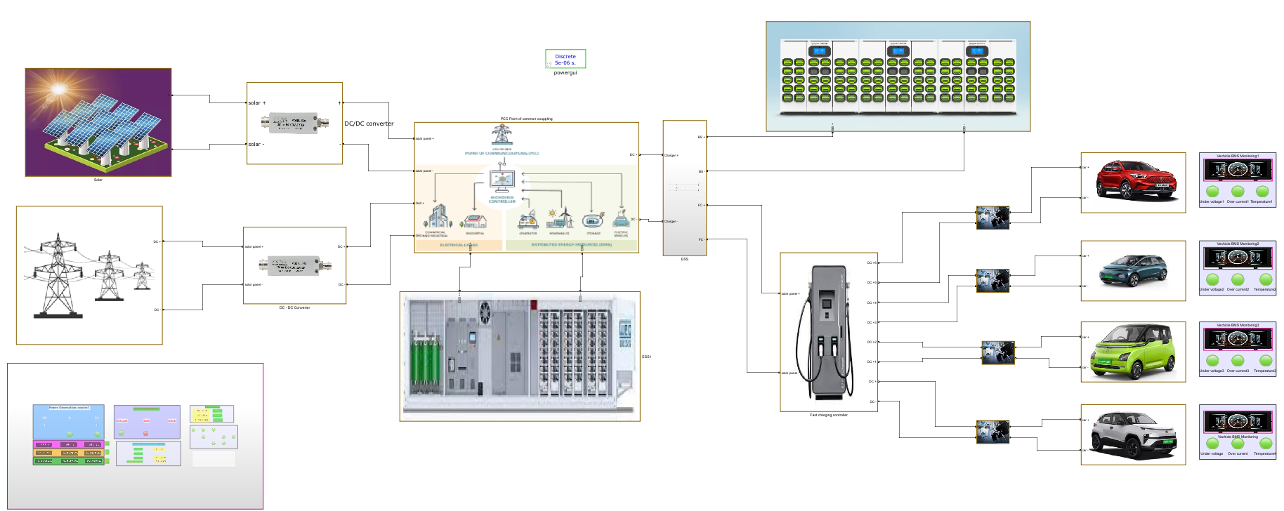
System Design
Swapping Station
Solar
Converter
PCC
Divider
Charging
Monitoring
Vehicles
Converter
Grid
ESS
Fast Charging
Central Monitoring System

Slide 12
PCC integration and Automation
Start
Grid Off
IF
Solar Available
IF
Solar Not Available
Grid Off
ESS ON
ESS
< 20%
Load On
ESS Charging > 80%
Load On
Power to Grid
Grid
Power
ON
Load On
No Load
ESS Charging
Upto Solar Available
Cycle Continuous

Slide 13
End to End Flow
Start
Check for the power source
Solar
ESS
Grid
PCC – Point of Common Coupling
Solar – ON → ESS Charge → Grid OFF → Load ON
Solar – ON → ESS >80% → [Grid DC- AC] OFF → Load ON
Solar – OFF → ESS ON → Grid OFF → Load ON
Solar – OFF → ESS <20% → [Grid DC- AC] ON → Load ON
Solar – OFF → ESS charge → [Grid AC- DC] ON → Load OFF
Battery Swapping Station
DC Fast Charging Station

Slide 14
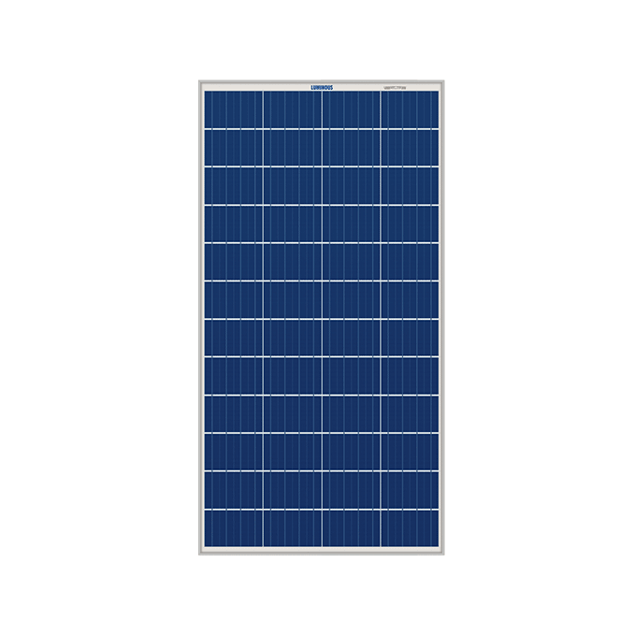
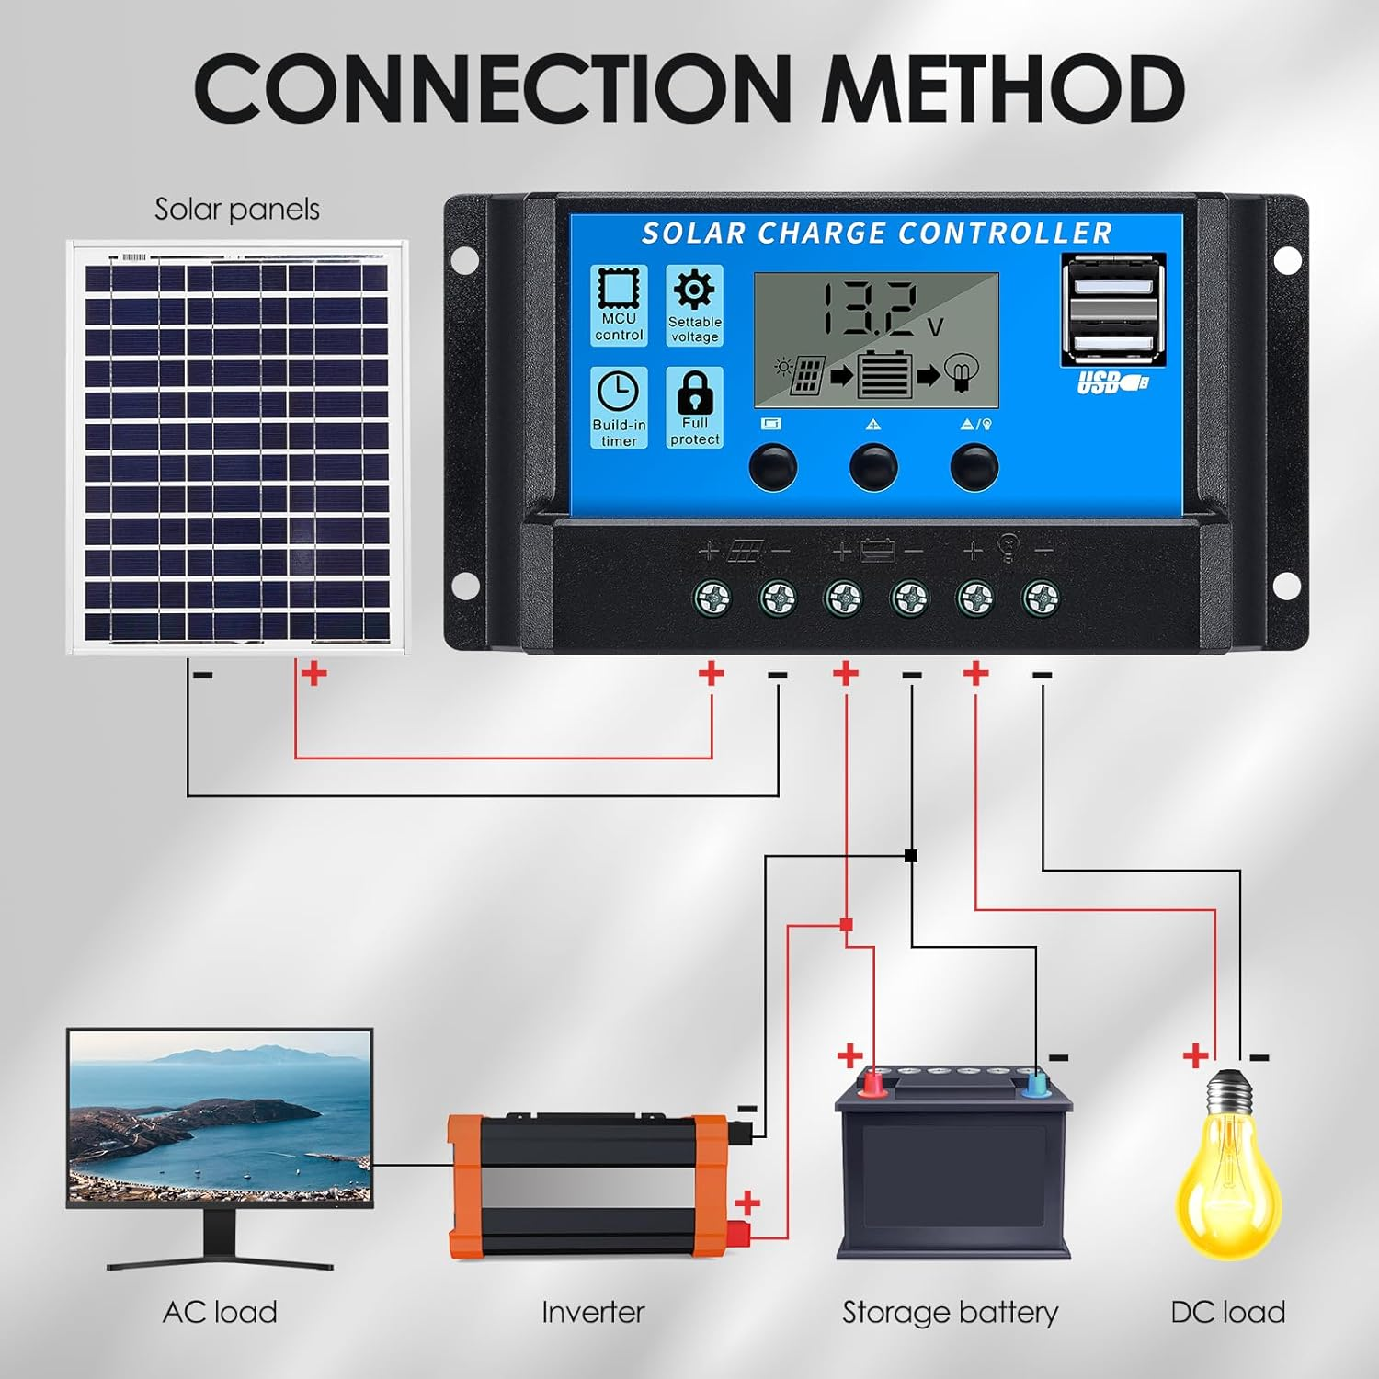
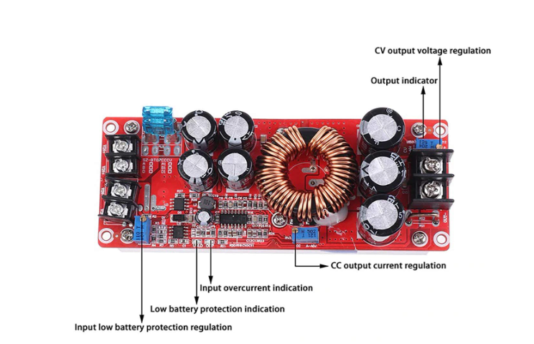
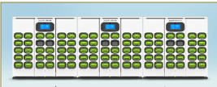


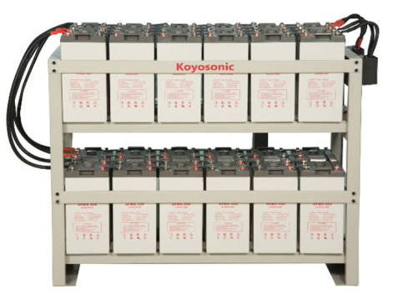
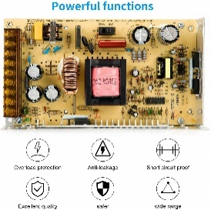
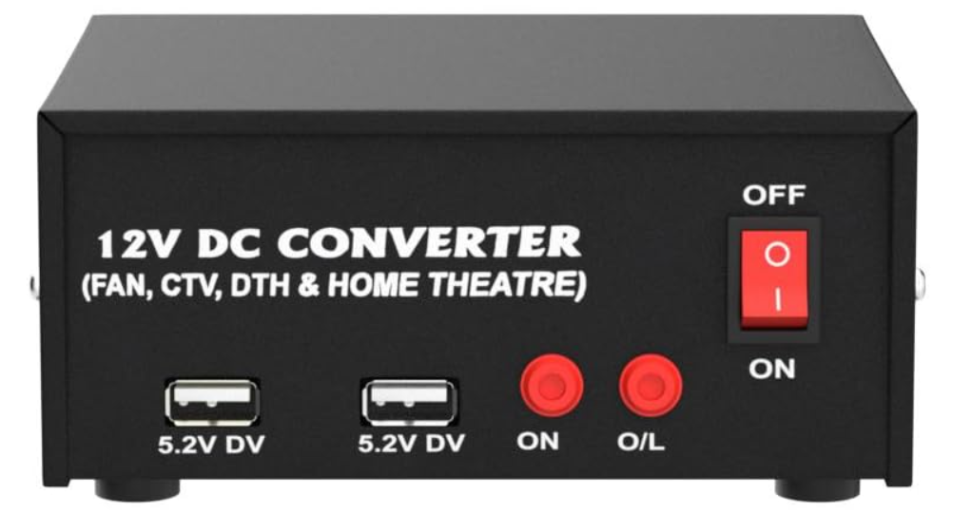
Automation Energy Sensor monitoring
Procurement_ Part – 2
Solar
Voltage, Current, Temp, RTC, Humidity, Light Intensity, SW – M/C_1
ESS
Voltage, Current, Temp, SW – M/C_2
Grid
AC – DC - Adopter → Voltage, Current , SW – M/C_3
DC – AC Converter
Voltage, Current(AC - Sensors) SW – M/C_4
Load
DC – DC Converter
1. Swapping - Voltage, Current, SW – M/C_4
2. Fast charge – 12 Batteries Voltage, Current, SW – M/C_5
Solar
DC – DC
Converter
M-1
SW_1
SW_5
M-5
SW_2
M-5
Grid
M-3
DC
M-2
AC
SW_3
DC
AC
M-4
SW_4

Slide 15
Integrating Energy source
Procurement_ Part – 1
Sources
Solar
Pannel – 1
Solar charger converter
2. ESS
Batteries -2
Grid
AC – DC - Adopter – XHM602
DC – AC Converter
Load
DC – DC Converter
1. Swapping - 10 Batteries
2. Fast charge – 12 Batteries
Solar
DC – DC
Converter
Grid
DC
AC
DC
AC

Slide 16
Automation Energy source
Solar
DC – DC
Converter
SW_1
SW_5
SW_2
Grid
DC
Conditions
Solar – ON → ESS Charge → Grid OFF → Load ON -→ [ON – S1,S2,S5] – [OFF – S3,S4]
Solar – ON → ESS >80% → [Grid DC- AC] ON → Load ON -→ [ON – S1,S2,S5,S4] – [OFF – S3]
Solar – OFF → ESS ON → Grid OFF → Load ON -→ [ON – S2,S3,S4,S5] – [OFF – S1]
Solar – OFF → ESS <20% → [Grid DC- AC] ON → Load ON -→ [ON – S3,S5] – [OFF – S1,S2,S4]
AC
SW_3
DC
AC
SW_4

Slide 17
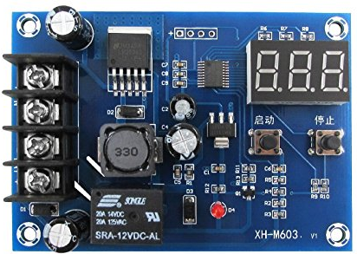
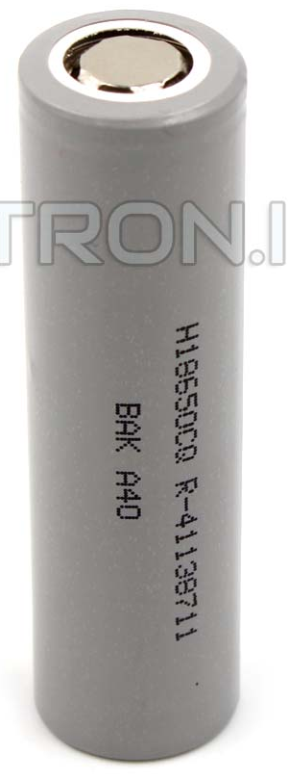
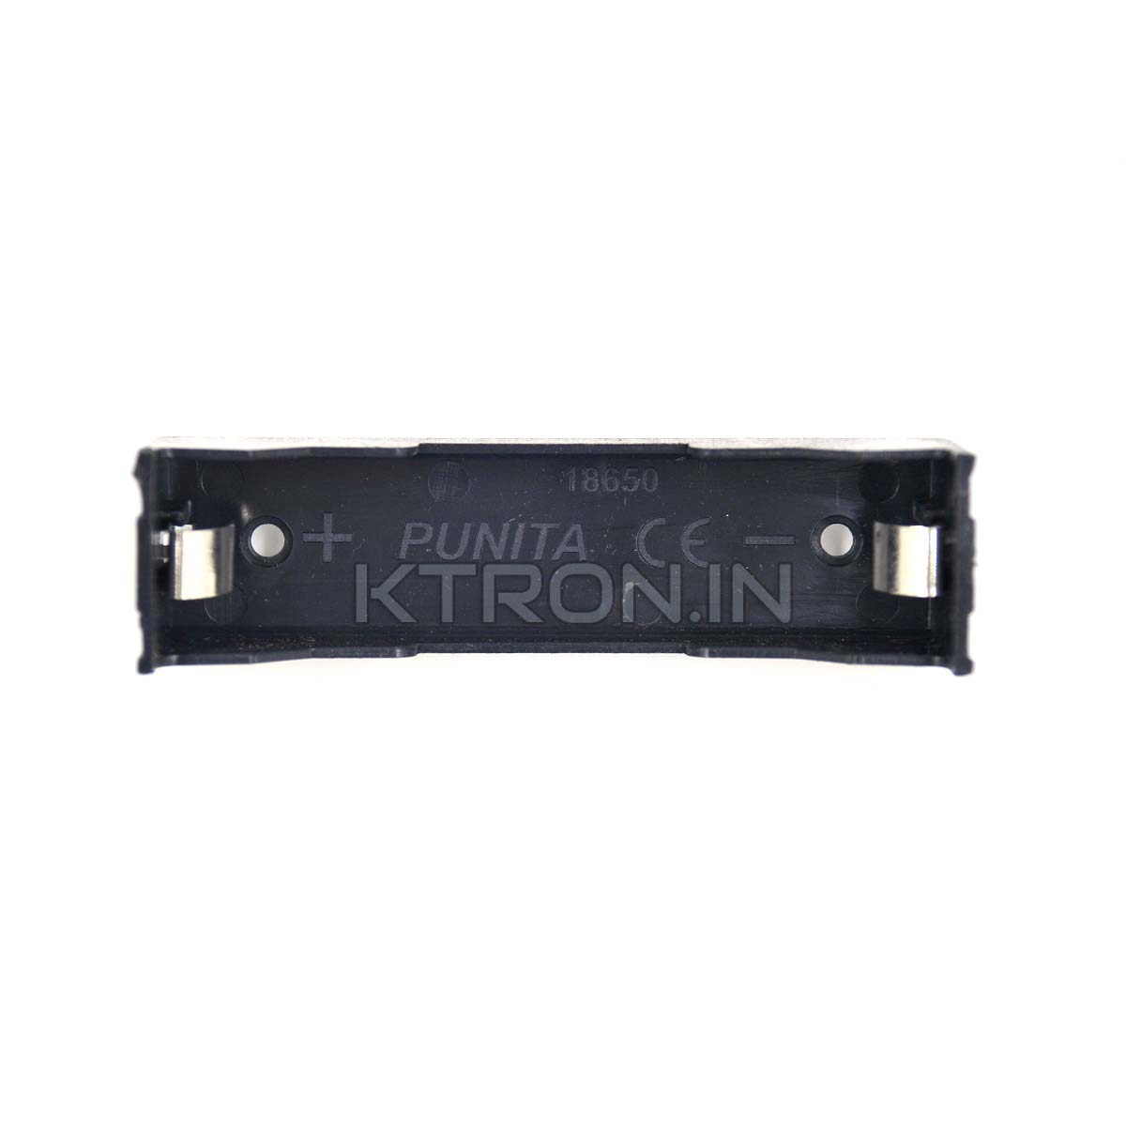
Load source
DC Power
Procurement_ Part – 3
Swapping
batteries - 10,
Centlot xt M60312V Digital charger controller
Voltage
Current
Temperature
M-5
M-6

Slide 18
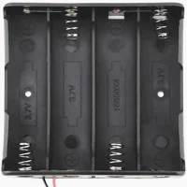
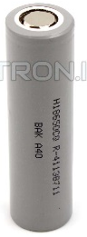
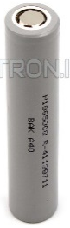
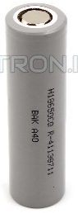
Load source
DC Power
Procurement_ Part – 4
Swapping
batteries - 3*4 = 12,
Centlot xt M60312V Digital charger controller
Voltage
Current
Temperature
M-5
M-7

Slide 19
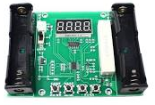
Discharge unit
Procurement_ Part – 5
Xcluma XHM240 - 18650

Slide 20
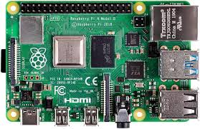



Solar
M/c – 1
Voltage, Current, Temp, Humidity, Light Intensity, SW – On/OFF
ESS
M/c – 2
Voltage, Current, SW – On/OFF
M/C – 1
M/C - 2
M/C - 3
M/C - 4
Grid
AC – DC - Adopter → Voltage, Current , SW – M/C_3
DC – AC Converter
Voltage, Current(AC - Sensors) SW – M/C_4

Slide 21
Swapping station
M/c – 5
Voltage, Current SW – On/OFF
M/C – 1
M/C - 2
Fast Charging
M/C_6
Voltage, Current, SW – M/C_4

Slide 22
Load source
DC Power
Procurement_ Part – 3
Swapping
batteries - 10,
Centlot xt M60312V Digital charger controller
Voltage
Current
Temperature
M-5
M-6

Slide 23
Bill of Material’s
S.No | Component | Qty | Specifications | Unit Cost (₹) | Total Cost (₹)
1 | Solar Panel (110W) | 1 | 23.02V, Polycrystalline | 3465 | 3465
2 | Solar Charge Controller (30A) | 2 | PWM, 12V/24V | 499 | 998
3 | Lead-Acid Battery (12V 15Ah) | 2 | Sealed, Rechargeable | 1299 | 2598
4 | ESP32 Microcontroller | 4 | WiFi + Bluetooth | 480 | 1920
5 | DC-DC Converter (1500W) | 1 | 12-48V to 24-72V Boost | 2045 | 2045
6 | Voltage/Current Sensors | 4 | ACS712 (30A), ZMPT101B (AC) | 225 | 1200
7 | Raspberry Pi 3B+ | 1 | For Real time monitoring | 4200 | 4200
 | Total | 15 |  | 12213 | 16426

Slide 24

Thankyou
"Engineering is the closest thing to magic that exists in the world."
– Elon Musk

